Slide 1



Epilepsy Awareness
This session has been designed by young people living with epilepsy.

Slide 2


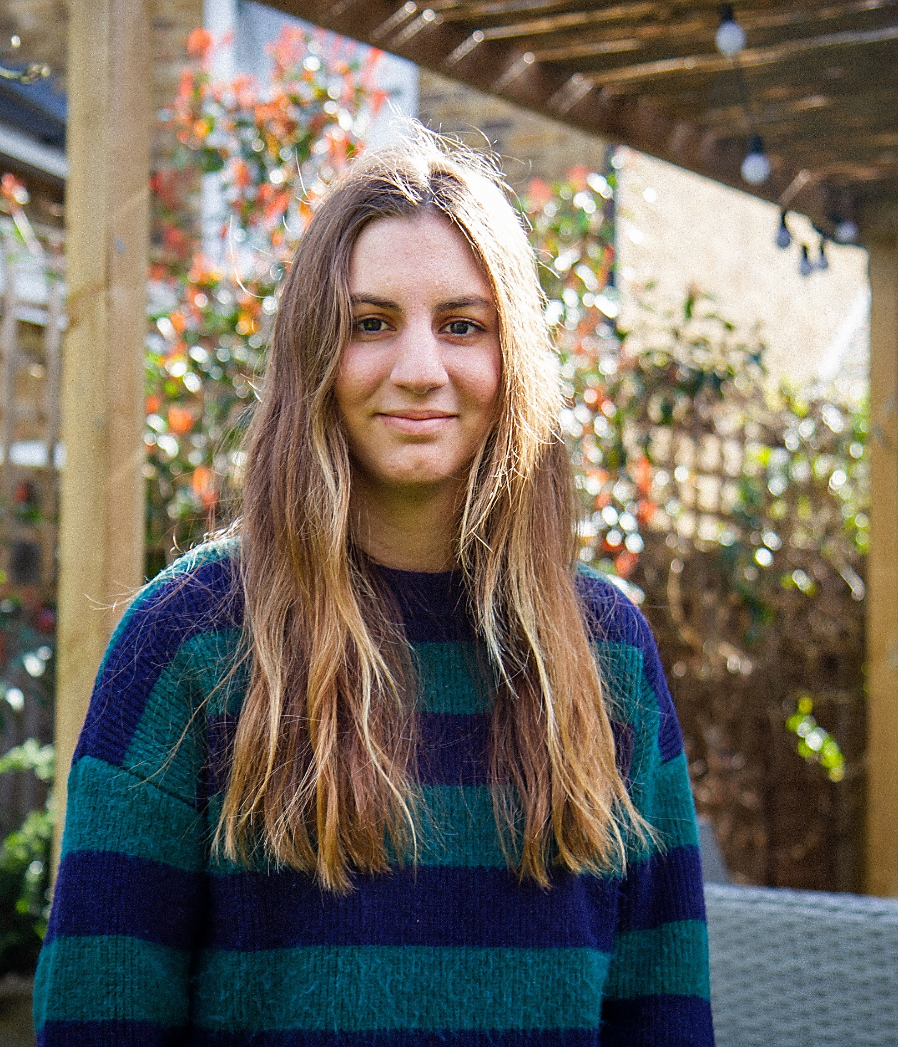
Welcome to our assembly
Young Epilepsy Loud in London (YELL) is a project for young people aged 13-25 who live with epilepsy in London.
We've been working together to share our stories and create this presentation to help you understand what it's like to grow up with epilepsy. Our goal is to raise awareness and show you how you can support your classmates who have epilepsy.
We hope you find this presentation interesting and learn something new. By the end, you'll know more about epilepsy and how to be a great friend to someone living with it.

Slide 3

What is Epilepsy?
Epilepsy is a neurological condition that disrupts the normal electrical activity our brains use to communicate with the rest of the body. This disruption causes repeated seizures.
Epilepsy can affect anyone, at any age, from any walk of life.

Slide 4

Epilepsy Statistics
There are around 103,600 children and young people with epilepsy in the UK (aged 0-24). This is the equivalent of 1 in 200 children and young people.
Around 3% of people with epilepsy are photosensitive, which means their seizures are brought on by flashing lights.
Around three-quarters of children will either outgrow their epilepsy or it will be well controlled by anti-seizure medications.

Slide 5
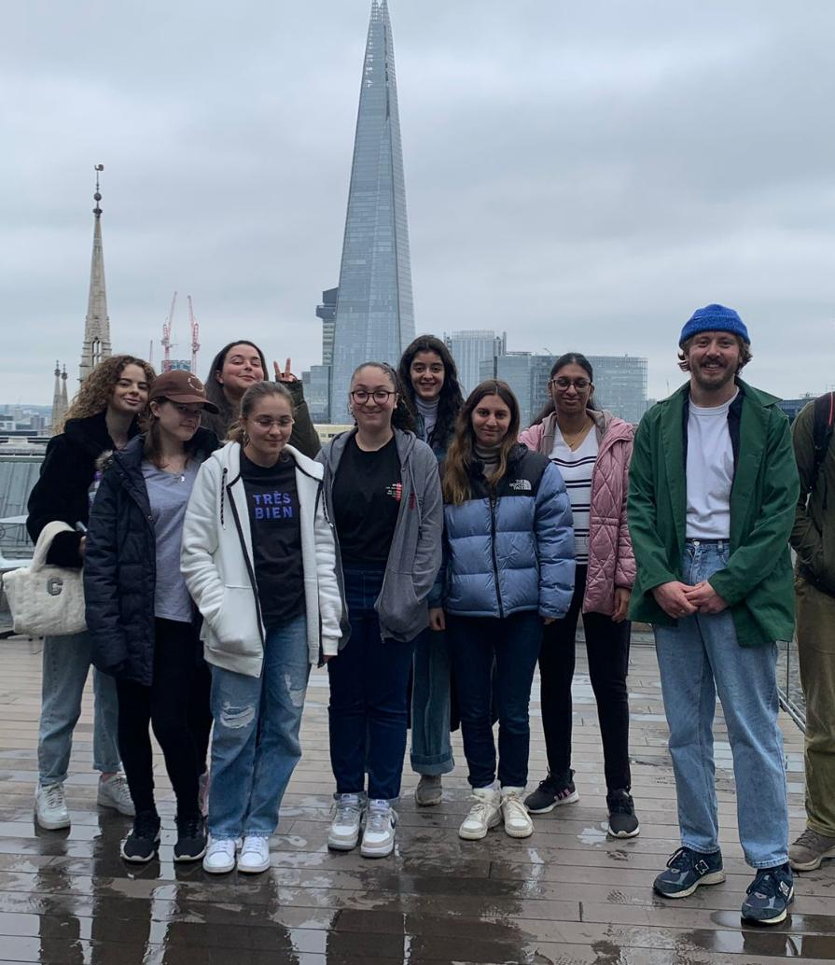
What is a seizure?
An epileptic seizure results from a sudden electrical burst in the brain that causes changes in sensation, behaviour or consciousness.
Seizure symptoms depend on where in the brain this abnormal burst of electrical activity happens. As a result, there are many different types of seizures - most usually last from a few seconds to a few minutes and usually stop without any treatment.

Slide 6

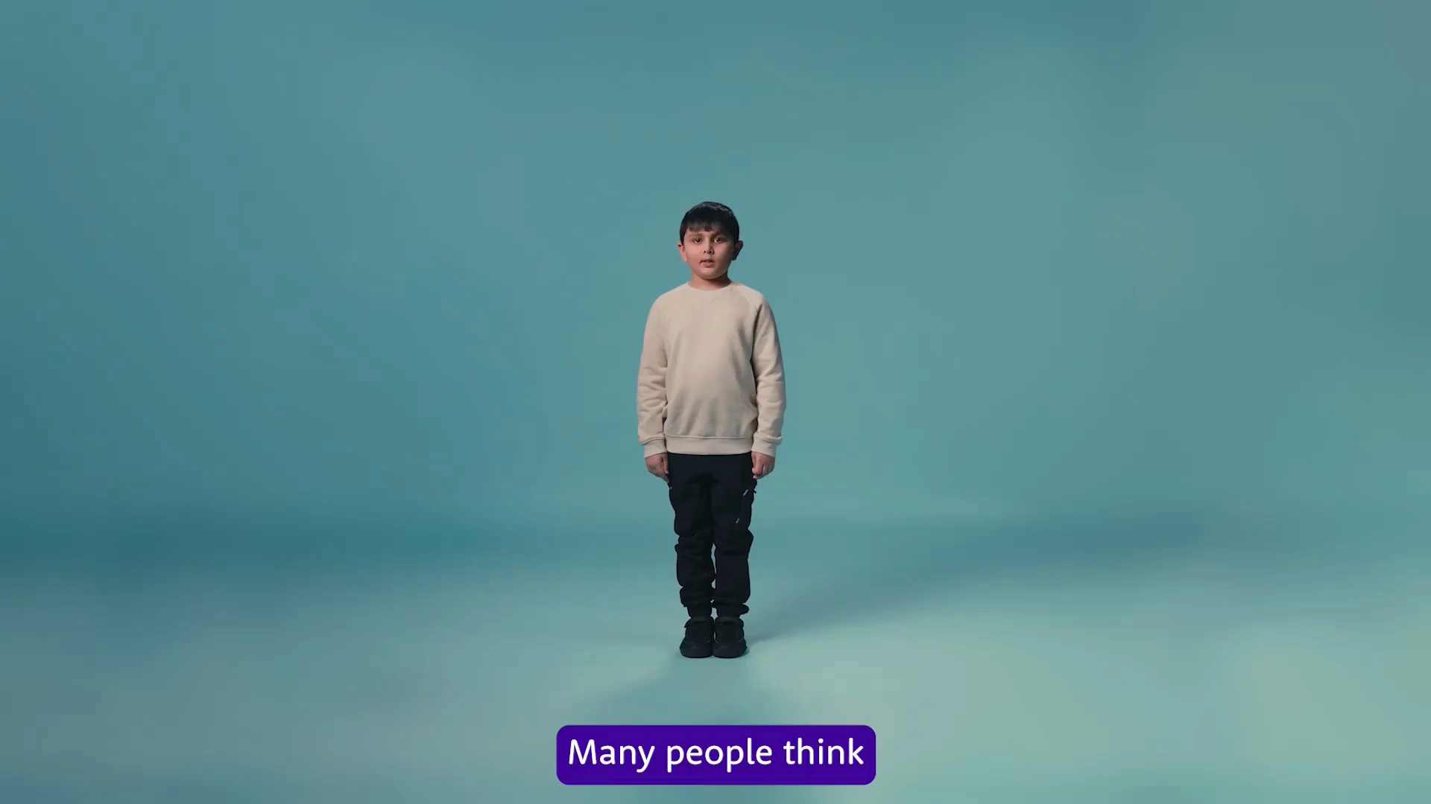


Slide 7



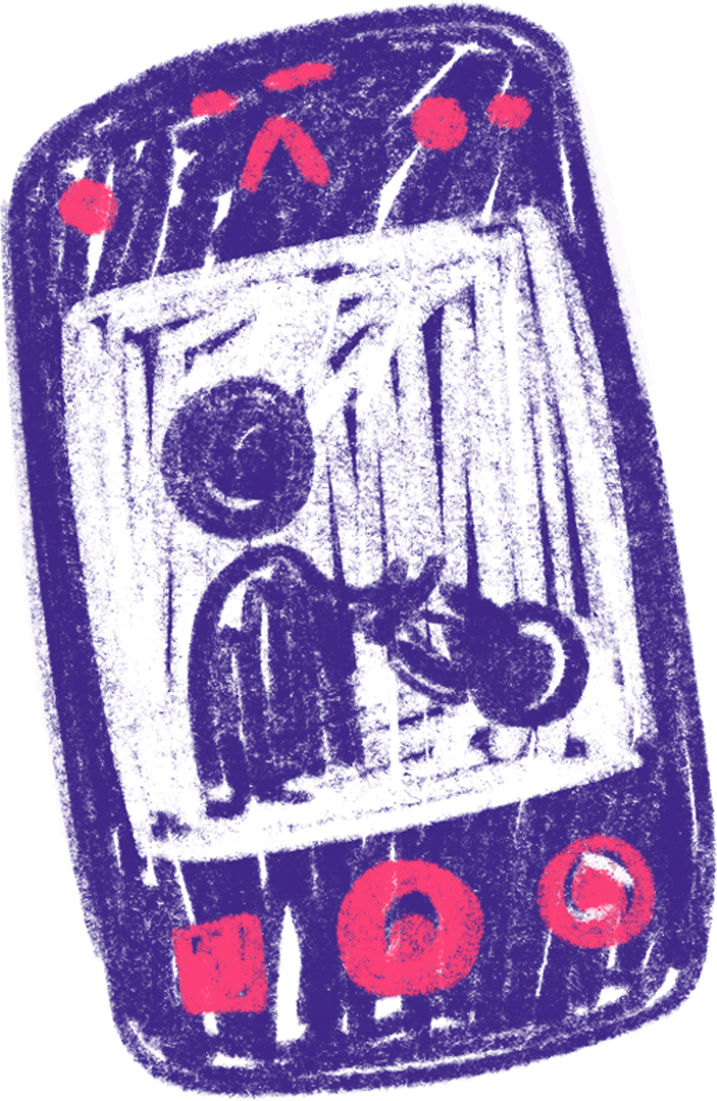

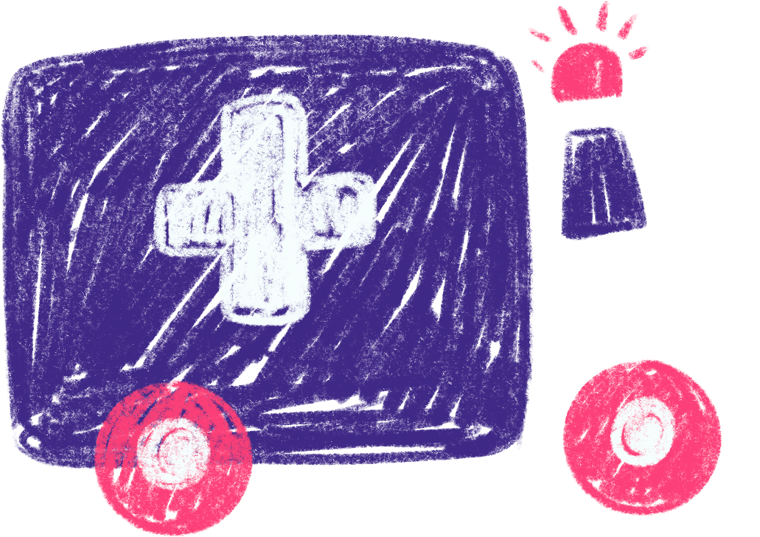
Seizure First Aid
Time the seizure
Stay with me until the seizure is over
Move harmful objects
Call 999 if the seizure is over 5 mins
Only administer emergency medication if trained to do so
Cushion
my head

Slide 8

Daily living with Epilepsy
“
Anti-seizure medication (ASMs) are the most common treatment for epilepsy. They don’t cure epilepsy or treat the cause but about 70% of people with epilepsy can achieve good seizure control through the regular use of ASMs.
With the right measures put in place epilepsy should not stop a young person living a ‘normal’ life.
I believe strongly that epilepsy doesn’t have to define you. It’s all about adapting and fully enjoying life, no matter the hurdles
Olivia

Slide 9
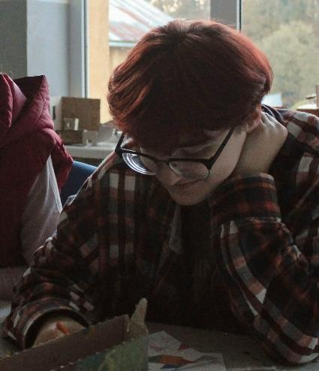
Epilepsy in School
21%
Epilepsy can have a significant impact on a child’s experience of school life. Whilst at school, children may depend on staff to recognise and respond to seizures. Seizures are not the only impact on school life – epilepsy can also have an impact on:
- Memory
- Sleep
- Mental Health
- Confidence
of children with epilepsy were excluded from activities or opportunities at school

Slide 10
Bullying
Stigma and bullying is common in epilepsy, often due to widespread misunderstanding about the condition.
This can lead to a young person with epilepsy having low self-esteem and not wanting to take part in learning and activities.
Bullying is an additional stress to young people with epilepsy, and stress is a common trigger for seizures.
“
I didn't know I’d been filmed having a seizure, until it was shared by half the school on social media. I was completely devastated.
Bethany
If you see someone being bullied, please report it to a teacher.

Slide 11


Inspiring stories
Renell’s Journey
Passion & Talent: Football has always been Renell’s love and strength.
Setback: An epilepsy diagnosis threatened to end his dream.
Determination: He refused to give up and kept pushing forward.
Achievement: Renell ended up playing for Santan Dave’s team in the Baller League, proving epilepsy doesn’t define ambition.

Slide 12
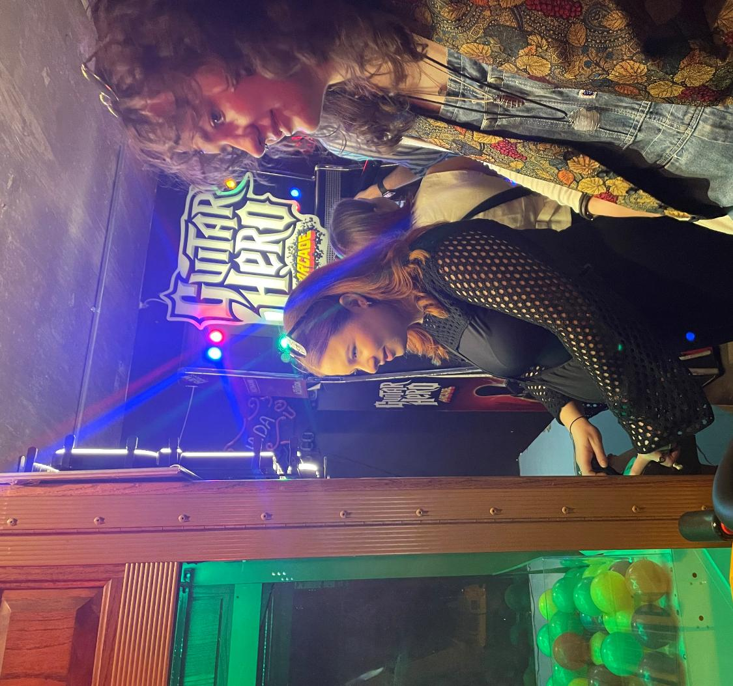
How to support a friend with epilepsy
Don’t assume I can’t do things – I can still enjoy sleepovers, school trips, and fun days out. Just ask me what works best.
Learn how I like to be supported – If I have a seizure, knowing what helps me feel safe and calm makes a big difference.
Understand that I might have off days – Sometimes I might seem tired, quiet, or not myself. That could be because of my epilepsy or the medication I take.
Ask questions if you’re unsure – I’d rather you ask than guess. I’m happy to explain what epilepsy means for me.
Be kind and include me – Feeling accepted and supported by friends makes school a much better place.

Slide 13
Question 1
Answer
How many different types of epileptic seizures are there, and do they all look the same?
There are over 40 different types of seizures!

Slide 14
Question 2
Answer
About how many children and young people in the UK have epilepsy?
Over 103,600 children and young people in the UK have epilepsy.
That’s about 1 in every 200.

Slide 15
Question 3
Answer
How can epilepsy affect someone's life?
Epilepsy can affect lots of things -
Like memory, sleep, mental health, confidence, and how someone feels at school.

Slide 16
Question 4
Answer
What should you do if you see someone having a seizure at school?
Time the seizure, move dangerous objects, cushion their head, call 999 if it lasts for more than 5 minutes.

Slide 17
Question 5
Answer
What are some good ways to support a friend with epilepsy at school?
Be kind and include them. Ask questions if you’re unsure.
Don’t assume they can’t do things.

Slide 18
Thank you for watching!
We hope you’ve enjoyed learning more about epilepsy and hearing the stories of some inspiring young people.
If you’re interested in finding out more or want to explore how to offer support, the next slide includes helpful resources and information.

Slide 19
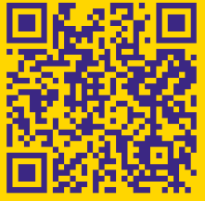
More information can be found here
Find us on social media

